Slide 1
Transformations of Functions

Slide 2
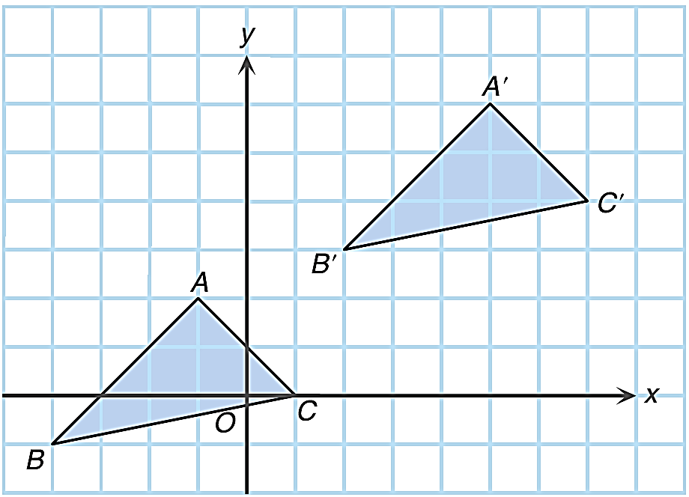

In junior forms, we have learnt the process of changing the position, size or orientation of a figure is called a transformation.
For example:
then translated rightwards by 6 units to triangle A′B′C′
Triangle ABC is translated upwards by 4 units
ABC is transformed to
A′B′C′.

Slide 3


Can the graph of a function be transformed?
Yes. We will first consider the translation and reflection of the graph of a function.

Slide 4
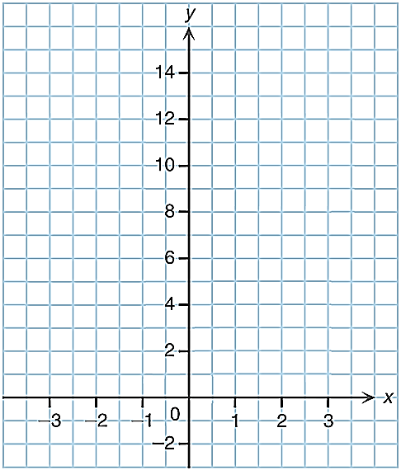
Translating Upwards or Downwards
Consider two functions f(x) = x² + 2 and g(x) = f(x) + 3 .
g(x) = f(x) + 3
= x² + 2 + 3
= x² + 5
The tabular representations of y = f(x) and y = g(x) are shown below.
x | −3 | −2 | −1 | 0 | 1 | 2 | 3
f(x) | 11 | 6 | 3 | 2 | 3 | 6 | 11
g(x) | 14 | 9 | 6 | 5 | 6 | 9 | 14
y = g(x)
×
×
×
×
×
×
y = f(x)
By plotting the graphs of y = f(x)
and y = g(x),
we see that the shapes
of the graphs of y = f(x) and y = g(x)
are the same.
×
×
×
×
×
×
×
×

Slide 5

If the graph of y = f(x) is translated
upwards by 3 units,
then the graph of y = f(x) + 3 is obtained.
y = f(x) + 3
y = f(x)
3 units
Every point on the graph of y = f(x) is translated upwards
by 3 units.

Slide 6
Consider two functions f(x) = x² + 2 and g(x) = f(x) − 4.
g(x) = f(x) − 4
= x² + 2 − 4
= x² − 2
The tabular representations of y = f(x) and y = g(x) are shown below.
x | −3 | −2 | −1 | 0 | 1 | 2 | 3
f(x) | 11 | 6 | 3 | 2 | 3 | 6 | 11
g(x) | 7 | 2 | −1 | −2 | −1 | 2 | 7
×
×
By plotting the graphs of y = f(x)
and y = g(x),
we see that the shapes
of the graphs of y = f(x) and y = g(x)
are the same.
y = f(x)
×
×
×
×
y = g(x)
×
×
×
×
×
×
×
×

Slide 7

If the graph of y = f(x) is translated
downwards by 4 units,
then the graph of y = f(x) − 4 is obtained.
y = f(x)
Every point on the graph of y = f(x) is translated downwards
by 4 units.
y = f(x) − 4
4 units

Slide 8


From the discussion on the previous slides, we obtain the following fact:
Translating the graph of y = f(x) upwards by k units
Translating the graph of y = f(x) downwards by k units
y
y
y = f(x) + k
y = f(x)
x
0
k units
k units
x
0
y = f(x)
y = f(x) – k
y = f(x)
y = f(x) + k
y = f(x)
y = f(x) – k

Slide 9
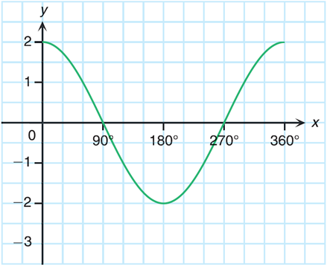
Follow-up question
It is given that f(x) = 2cos x and g(x) = 2cos x − 1.
(a) If f(x) is transformed to g(x), describe the transformation on
the graph of y = f(x).
(b) The figure shows the graph of y = f(x). Using the result of (a),
sketch the graph of y = g(x).
(a) g(x) = 2 cos x − 1
y = f(x)
= f(x) − 1
∴ The graph of y = f(x) is
translated downwards by
1 unit to give the graph of
y = g(x).

Slide 10
Follow-up question
It is given that f(x) = 2cos x and g(x) = 2cos x − 1.
(a) If f(x) is transformed to g(x), describe the transformation on
the graph of y = f(x).
(b) The figure shows the graph of y = f(x). Using the result of (a),
sketch the graph of y = g(x).
(b)
Steps to sketch the new graph:
y = f(x)
×
×
1. Mark a few points, such as
vertices, on the original graph.
×
×
×
×
2. Locate the images of these
points after transformation.
×
×
×
×
×
×
×
×
3. Join the images with a smooth
curve. Make sure the shape of
the new graph is the same as
that of the original graph.
×
×
×
1 unit
y = g(x)
×

Slide 11
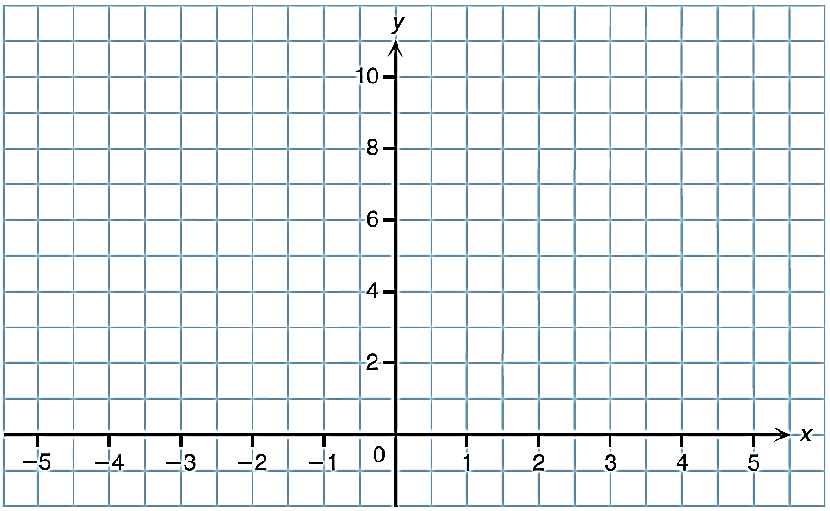
Translating Leftwards or Rightwards
Consider two functions f(x) = x² + 1 and g(x) = f(x + 1) .
g(x) = f(x + 1)
= (x + 1)² + 1
The tabular representations of y = f(x) and y = g(x) are shown below.
x | −4 | −3 | −2 | −1 | 0 | 1 | 2 | 3
f(x) | … | 10 | 5 | 2 | 1 | 2 | 5 | 10
g(x) | 10 | 5 | 2 | −1 | 2 | 5 | 10 | …
By plotting the graphs of y = f(x)
and y = g(x),
×
×
×
×
we see that the
shapes of the graphs of y = f(x)
and y = g(x) are the same.
y = g(x)
y = f(x)
×
×
×
×
×
×
×
×
×
×

Slide 12
If the graph of y = f(x) is translated
leftwards by 1 unit,
then the graph of y = f(x + 1) is obtained.
1 unit
y = f(x + 1)
y = f(x)
Every point on the graph of y = f(x) is translated leftwards
by 1 unit.

Slide 13
Consider two functions f(x) = x² + 1 and g(x) = f(x − 2) .
g(x) = f(x − 2)
= (x − 2)² + 1
The tabular representations of y = f(x) and y = g(x) are shown below.
x | −3 | −2 | −1 | 0 | 1 | 2 | 3 | 4 | 5
f(x) | 10 | 5 | 2 | 1 | 2 | 5 | 10 | ... | …
g(x) | … | … | 10 | 5 | 2 | 1 | 2 | 5 | 10
By plotting the graphs of y = f(x)
and y = g(x),
×
×
×
×
we see that the
shapes of the graphs of y = f(x)
and y = g(x) are the same.
×
×
×
×
y = f(x)
×
×
×
y = g(x)
×
×

Slide 14
If the graph of y = f(x) is translated
rightwards by 2 units,
then the graph of y = f(x − 2) is obtained.
2 units
Every point on the graph of y = f(x) is translated rightwards
by 2 units.
y = f(x)
y = f(x − 2)

Slide 15
From the discussion on the previous slides, we obtain the following fact:
Translating the graph of y = f(x) leftwards by k units
Translating the graph of y = f(x) rightwards by k units
y
y
y = f(x + k)
k units
y = f(x)
x
x
0
0
k units
y = f(x)
y = f(x – k)
y = f(x)
y = f(x + k)
y = f(x)
y = f(x – k)

Slide 16
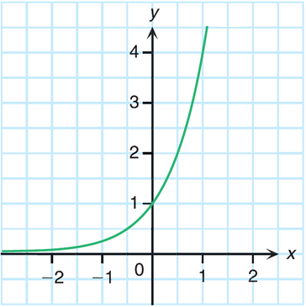
Follow-up question
It is given that f(x) = 4^{x} and g(x) = 4^{x} ⁻ ¹.
(a) If f(x) is transformed to g(x), describe the transformation on
the graph of y = f(x).
(b) The figure shows the graph of y = f(x). Using the result of (a),
sketch the graph of y = g(x).
(b)
(a) g(x) = 4^{x} ⁻ ¹
= f(x − 1)
∴ The graph of y = f(x) is
translated rightwards by
1 unit to give the graph of
y = g(x).
y = f(x)

Slide 17
Follow-up question
It is given that f(x) = 4^{x} and g(x) = 4^{x} ⁻ ¹.
(a) If f(x) is transformed to g(x), describe the transformation on
the graph of y = f(x).
(b) The figure shows the graph of y = f(x). Using the result of (a),
sketch the graph of y = g(x).
(b)
×
×
1 unit
×
×
×
×
y = f(x)
y = 4^{x} ⁻ ¹
×
×

Slide 18
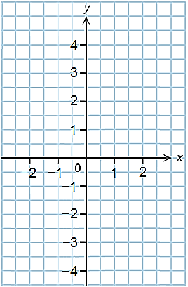
Reflection about the x-axis
Consider the function f(x) = x².
The tabular representations of y = f(x)
and y = −f(x) are shown.
y = f(x)
×
×
x | − 2 | − 1 | 0 | 1 | 2
f(x) | 4 | 1 | 0 | 1 | 4
−f(x) | − 4 | − 1 | 0 | − 1 | − 4
−f(x) = −x²
×
×
By plotting the graphs of y = f(x) and
y = −f(x),
×
we see that the graphs of
y = f(x) and y = −f(x) show reflectional symmetry with each other about the x-axis.
×
×
×
×
y = −f(x)

Slide 19
y = f(x)
In fact, the graph of y = −f(x)
can be obtained by reflecting the
graph of y = f(x) about the x-axis.
y = −f(x)

Slide 20
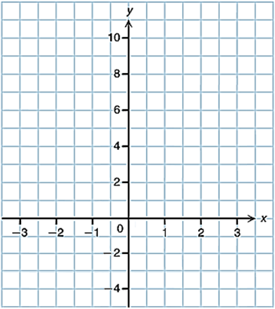
Reflection about the y-axis
Consider the function f(x) = 3x + 6.
The tabular representations of y = f(x) and y = f(−x) are shown.
x | −3 | −2 | −1 | 0 | 1 | 2 | 3
f(x) | −3 | 0 | 3 | 6 | 9 | … | …
f(−x) | … | … | 9 | 6 | 3 | 0 | −3
×
×
f(−x) = −3x + 6
×
By plotting the graphs of y = f(x) and
y = f(−x),
y = f(x)
×
×
y = f(−x)
we see that the graphs of
y = f(x) and y = f(−x) show reflectional symmetry with each other about the y-axis.
×
×
×
×

Slide 21
In fact, the graph of y = f(−x)
can be obtained by reflecting the
graph of y = f(x) about the y-axis.
y = f(x)
y = f(−x)

Slide 22
From the discussion on the previous slides, we obtain the following fact:
Reflecting the graph of y = f(x) about the x-axis
Reflecting the graph of y = f(x) about the y-axis
y
y
y = f(x)
x
x
0
0
y = −f(x)
y = f(x)
y = f(−x)
y = f(x)
y = –f(x)
y = f(x)
y = f(–x)

Slide 23
Follow-up question
Consider the function f(x) = 2x² + 7x – 3. Its graph is reflected about the y-axis to give the graph of y = g(x). Find the algebraic representation of g(x).
y
x
0
y = 2x² + 7x – 3
y = g(x)

Slide 24

Let us investigate the effect on the
graph of y = f(x) if f(x) is multiplied
by 2 or .

Slide 25

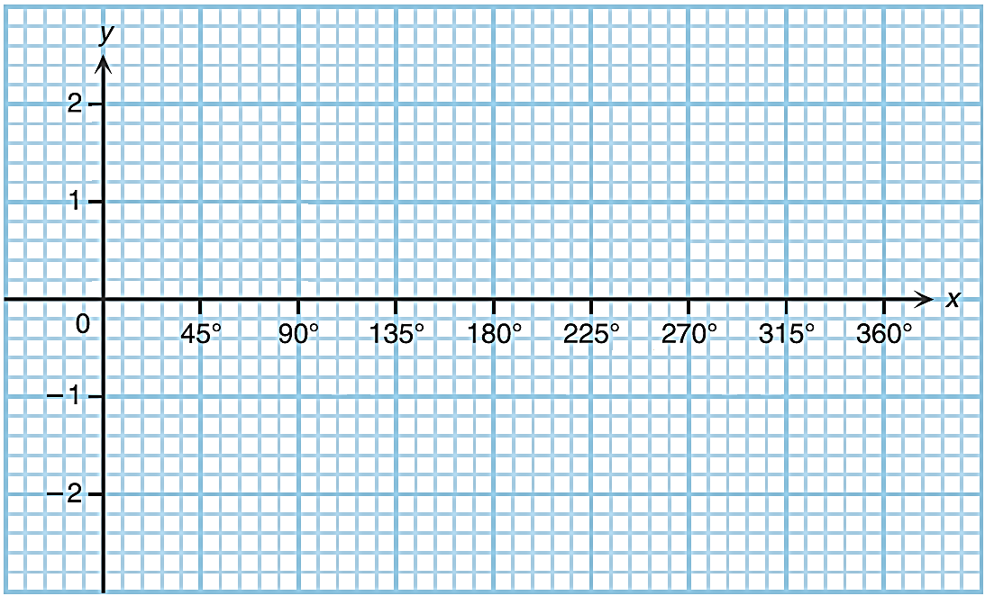

Enlargement and Reduction along the y-axis
Consider the function f(x) = cos x for 0° ≤ x ≤ 360°.
The tabular representations of f(x) and 2f(x) are shown below.
x | 0° | 45° | 90° | 135° | 180° | 225° | 270° | 315° | 360°
f(x) | 1 | 0.7 | 0 | −0.7 | −1 | −0.7 | 0 | 0.7 | 1
2f(x) | 2 | 1.4 | 0 | −1.4 | −2 | −1.4 | 0 | 1.4 | 2
2f(x) = 2cos x
By plotting the graphs of
y = f(x) and y = 2f(x),
y =2f(x)
×
×
×
×
we see that the graph of
y = 2f(x) can be obtained by enlarging the graph of y = f(x) along the y-axis to 2 times
the original.
×
y = f(x)
×
×
×
×
×
×
×
×
×
×
×
The y-coordinate of each point of the graph of y = 2f(x) is twice that of its corresponding point on the graph of y = f(x).

Slide 26
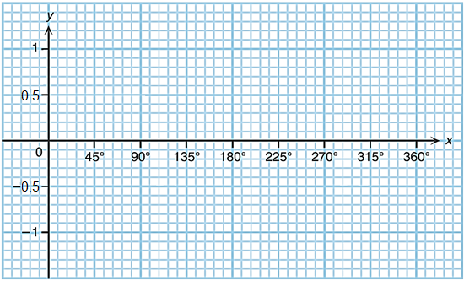
Consider the function f(x) = cos x for 0° ≤ x ≤ 360°.
The tabular representations of f(x) and f(x) are shown below.
x | 0° | 45° | 90° | 135° | 180° | 225° | 270° | 315° | 360°
f(x) | 1 | 0.7 | 0 | −0.7 | −1 | −0.7 | 0 | 0.7 | 1
f(x) | 0.5 | 0.35 | 0 | −0.35 | −0.5 | −0.35 | 0 | 0.35 | 0.5
1
1
f(x)= cosx
2
2
By plotting the graphs of
y = f(x) and y = f(x),
y =f(x)
×
×
×
×
we see that the graph of
y = f(x) can be obtained by
reducing the graph of y = f(x) along the y-axis to times
the original.
×
y = f(x)
×
×
×
×
×
×
×
×
×
×
×
The y-coordinate of each point of the graph
of y = f(x) is half that of its corresponding
point on the graph of y = f(x).

Slide 27
From the discussion on the previous slides, we obtain the following fact:
Enlarging the graph of y = f(x) along
the y-axis to k times the original
Reducing the graph of y = f(x) along
the y-axis to times the original
y
y
y = kf(x)
(k > 1)
y = f(x)
x
x
0
y = f(x)
0
y = f(x)
(k > 1)
y = f(x)
y = kf(x)
, where k > 1
y = f(x)
y = f(x)
, where k > 1

Slide 28

Let us investigate the effect on the
graph of y = f(x) if x is multiplied
by 2 or .

Slide 29

Enlargement and Reduction along the x-axis
Consider the function f(x) = cos x for 0° ≤ x ≤ 360° again.
The tabular representations of f(x) and f(2x) are shown below.
x | 0° | 45° | 90° | 135° | 180° | 225° | 270° | 315° | 360°
f(x) | 1 | 0.7 | 0 | −0.7 | −1 | −0.7 | 0 | 0.7 | 1
f(2x) | 1 | 0 | −1 | 0 | 1 | 0 | −1 | 0 | 1
f(2x) = cos2x
y =f(x)
By plotting the graphs of
y = f(x) and y = f(2x),
×
×
×
×
×
we see that the graph of y = f(2x) can be obtained by reducing the graph of y = f(x) along the x-axis
to times the original.
×
×
×
×
×
×
×
×
y =f(2x)
×
×
×
The x-coordinate of each point of the graph of y = f(2x) is half that of its corresponding point on the graph of y = f(x).

Slide 30
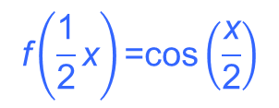

Consider the function f(x) = cos x for 0° ≤ x ≤ 360°.
The tabular representations of f(x) and are shown below.
x | 0° | 45° | 90° | 135° | 180° | 225° | 270° | 315° | 360°
f(x) | 1 | 0.7 | 0 | −0.7 | −1 | −0.7 | 0 | 0.7 | 1
 | 1 | 0.9 | 0.7 | 0.4 | 0 | −0.4 | −0.7 | −0.9 | −1
By plotting the graphs of
y = f(x) and y = ,
y =f(x)
×
×
×
×
×
×
×
we see that the graph of y =
can be obtained by enlarging the
graph of y = f(x) along the x-axis
to 2 times the original.
×
×
×
×
×
×
×
×
×
×
The x-coordinate of each point of the graph of y = is
twice that of its corresponding point on the graph of y = f(x).

Slide 31
From the discussion on the previous slides, we obtain the following fact:
Reducing the graph of y = f(x) along
the x-axis to times the original
Enlarging the graph of y = f(x) along
the x-axis to k times the original
y
y
y = f
(k > 1)
y = f(x)
y = f(kx)
(k > 1)
x
x
0
0
y = f(x)
y = f(x)
y = f(kx)
, where k > 1
y = f(x)
y =
, where k > 1

Slide 32
The following table summarizes the transformations of the graph of a function y = f(x) and the corresponding transformations of the function.
Transformation of the graph | Transformation of the function
Translate upwards by k units, where k > 0
f(x) + k
Translate downwards by k units, where k > 0
f(x) − k
Translate leftwards by k units, where k > 0
f(x + k)
Translate rightwards by k units, where k > 0
f(x − k)
Reflect about the x-axis
−f(x)
Reflect about the y-axis
f(−x)

Slide 33

Transformation of the graph | Transformation of the function
Enlarge along the y-axis to k times its original, where k > 1
kf(x)
Reduce along the y-axis to times its
original, where k > 1
Enlarge along the x-axis to k times its original, where k > 1
Reduce along the x-axis to times its
original, where k > 1
f(kx)

Slide 34
Follow-up question
In the figure, the graph of y = g(x)
is obtained by transforming the
graph of y = 2x² – 2.
Describe the transformation
on the graph of y = 2x² – 2.
(b) Find the algebraic
representation of g(x).
y
y = 2x² – 2
y = g(x)
x
−3
−1
0
3
1
The graph of y = 2x² – 2 is enlarged along the x-axis to
3 times the original to give the
graph of y = g(x).
(b)

